Slide 1
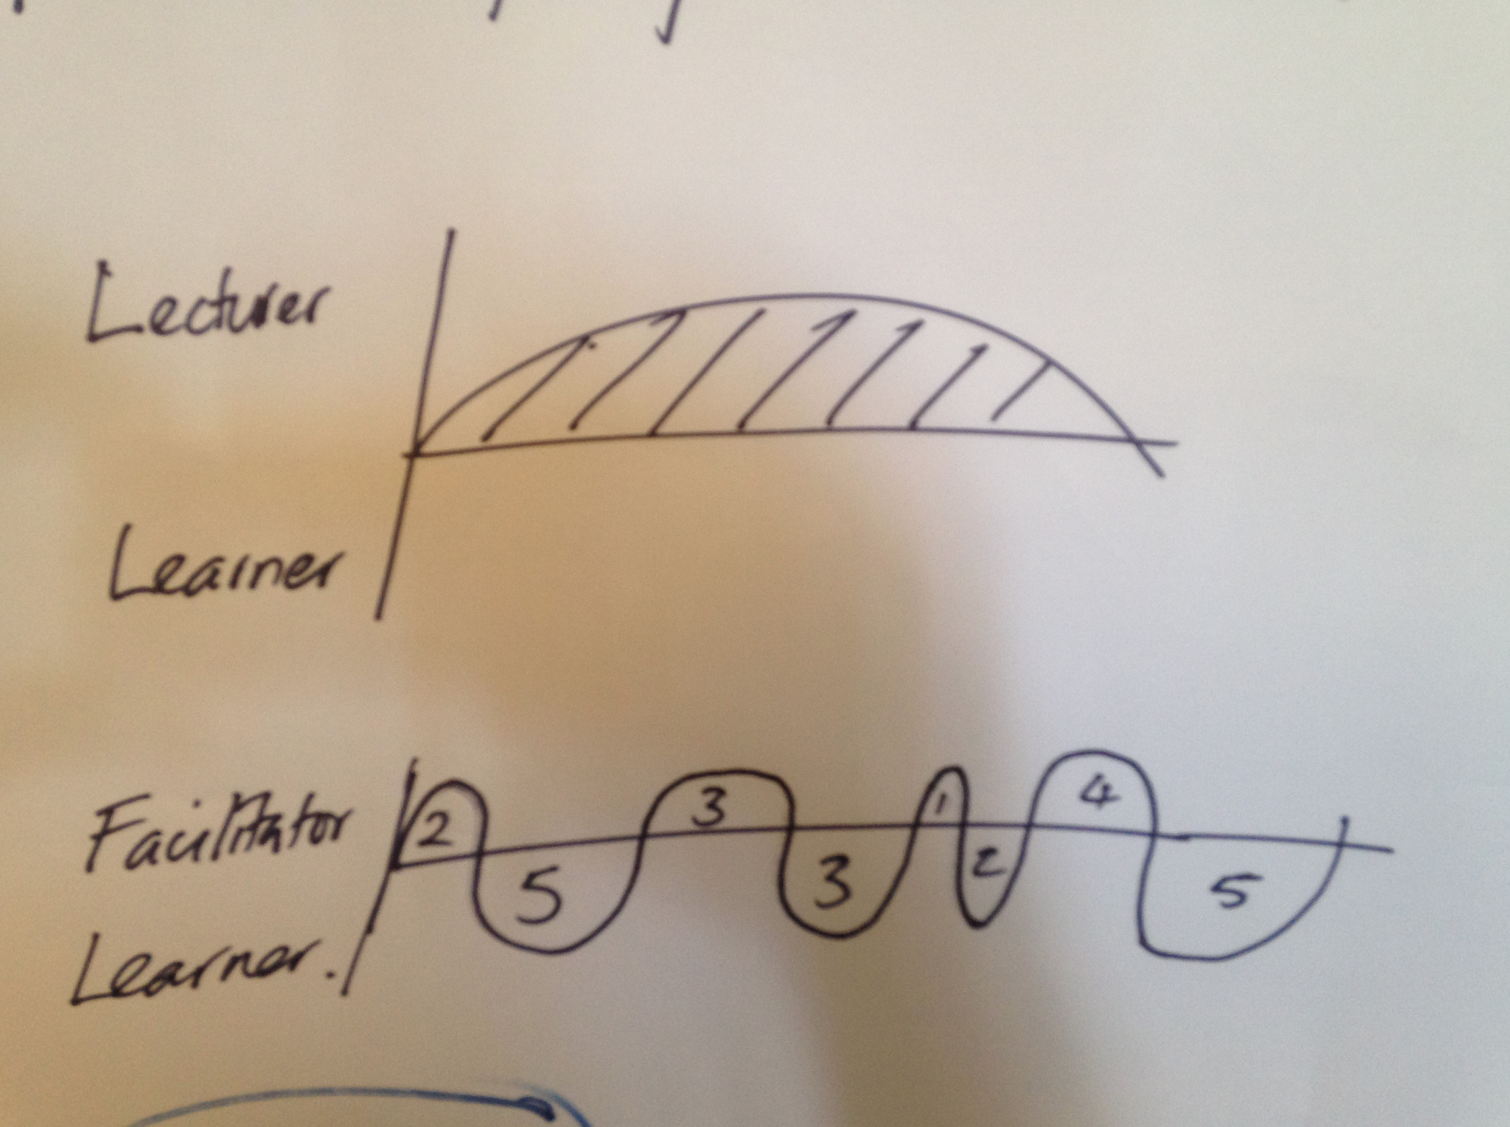

Slide 2
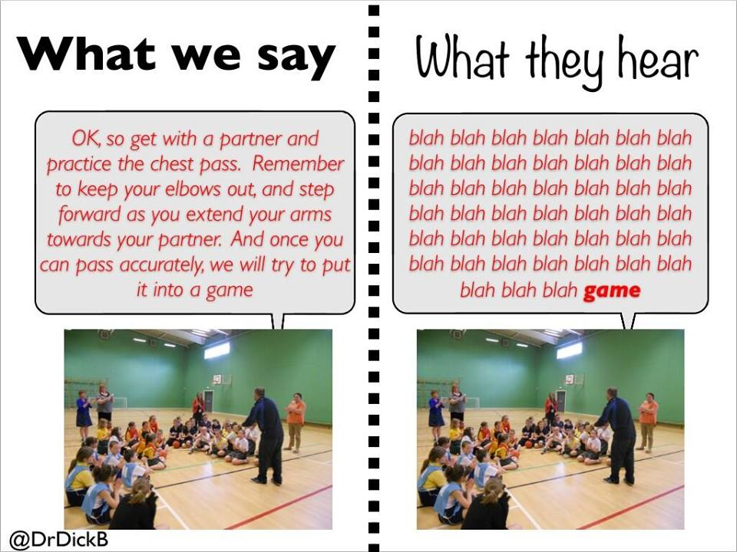
CATCH Them – COACH Them

Slide 3

Vivid Image/Story Telling

Slide 4
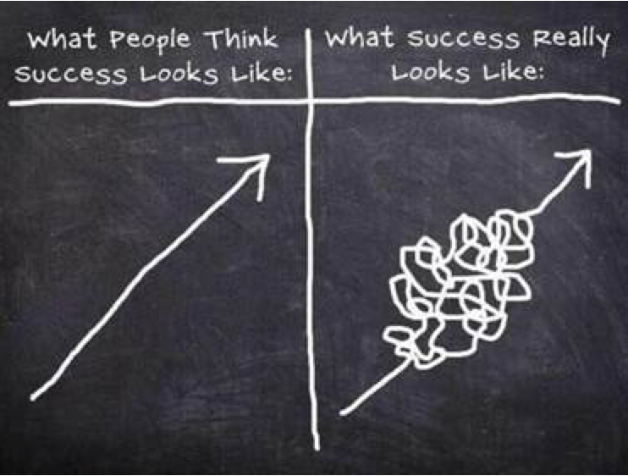
Learning is MESSY

