Slide 1
‘Priceless’ Principles
Give LEARNER plenty of Practice
Make everything R elevant
Involve LEARNER in their learning
Create a supportive Climate
Build on LEAERNER’S Experience / knowledge / skills
Adopt a Learner-centred approach
Make sessions Enjoyable
Help LEARNER Self-reflect
LEARNER’S experience Success

Slide 2
CATCH Them – COACH Them

Slide 3
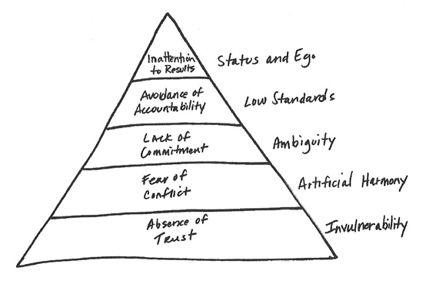
Lenzione’s 5 Dysfunctions of a Team

Slide 4
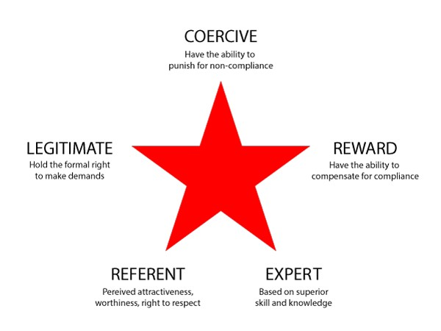
5 Sources of Power

