Slide 1
Listening
Things that disrupt listening:
Listening to REPLY & not Listening to UNDERSTAND
attention switching internally to what you want to say next
assuming you know what they are going to say
Things that improve listening:
observing body language, voice, changes
placing 100% attention on speaker (eye contact)
using supportive body language
using encouragement, summarising, reviewing

Slide 2
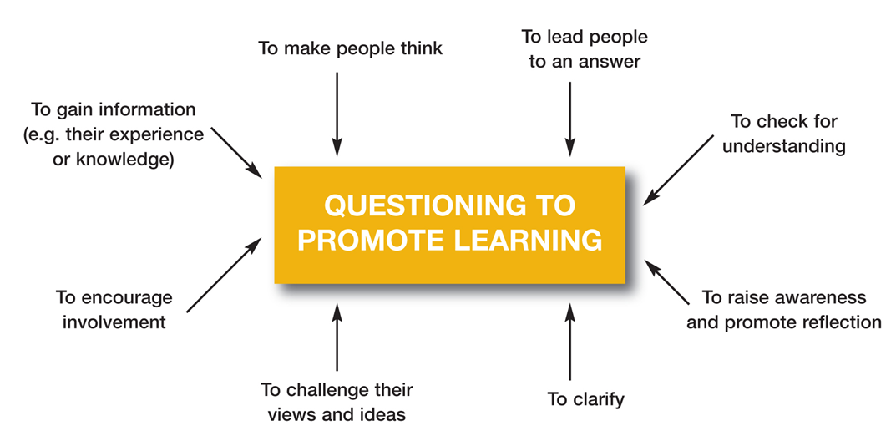
Questions to promote learning

Slide 3
Structuring questions
Closed questions often start with a verb (e.g. can, are, have, will) and are used to:
check facts or for understanding
find out what others know or can do
increase clarity of thinking
identify issues for further exploration
Open questions best start with WHAT (or TELL me) and can be used to:
share experiences and feelings
raise awareness and encourage self-reflection
apply new skills and information
challenge assumptions and attitudes

Slide 4
tips
Avoid:
leading questions
expecting the ‘right’ answer
WHY questions
Try to:
keep questions simple
contextualise your questions
use WHAT or TELL ME questions
Follow-ons
Listen 100% with your ears, eyes and whole body – never finish a sentence or interrupt
Pick out their key words (their line of interest) and always use THEIR words not your substitutes
Build your next question or statement around these words

